Slide 1
Swift Machine Learning Model Serving Scheduling: A Region Based Reinforcement Learning Approach
Heyang Qin¹, Syed Zawad¹, Yanqi Zhou², Lei Yang¹, Dongfang Zhao¹, Feng Yan¹
¹University of Nevada, Reno
²Google Brain
Resource Acknowledgement

Slide 2
Machine Learning
Vision
Speech
High Computation Cost
High Memory Requirement
Difficult to Deploy Models
Natural Language

Slide 3
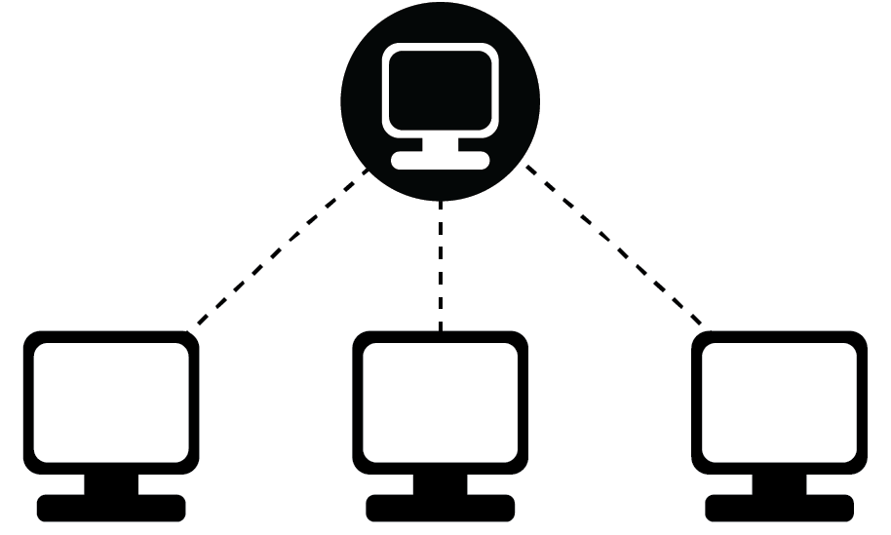
Machine Learning as a Service
MLaaS
(Machine Learning as Service)
Vision
Building
Speech
Training
Natural Language
Serving

Slide 4
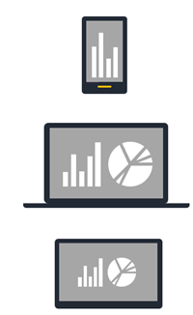
Machine Learning as a Service
Clients
Machine Learning Models
Servers
“Cat”
Machine Learning Model
API
“Hello”
“What’s the weather?”
“Rainy”
Image from AzureML

Slide 5
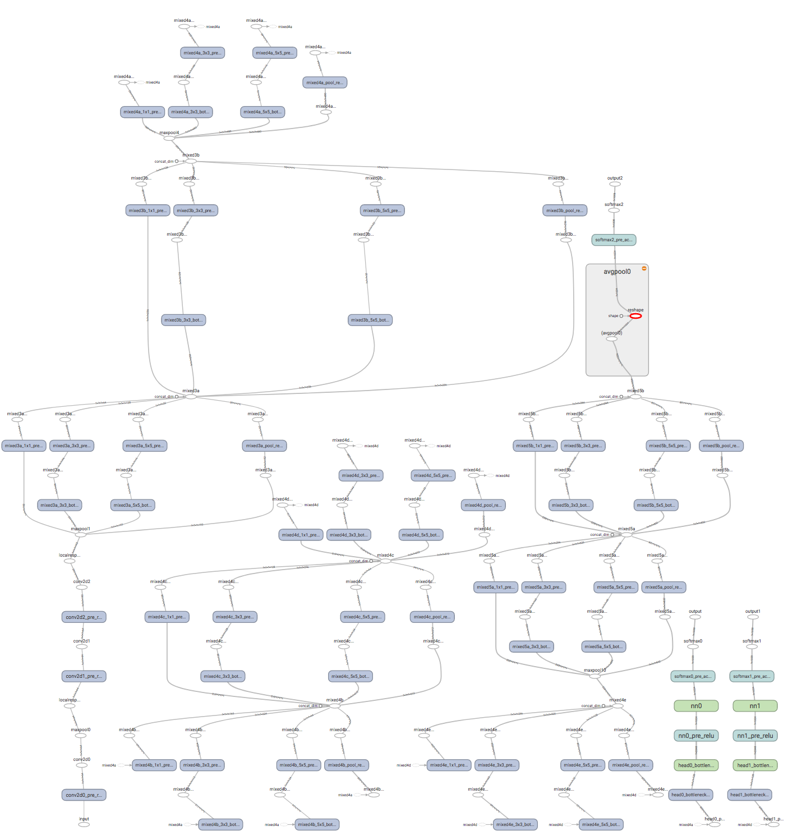
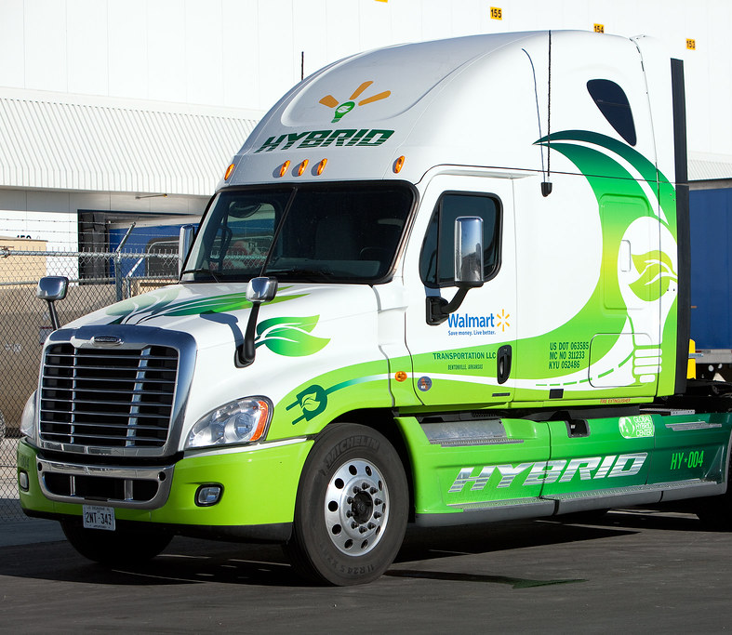
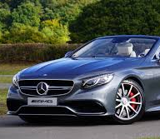
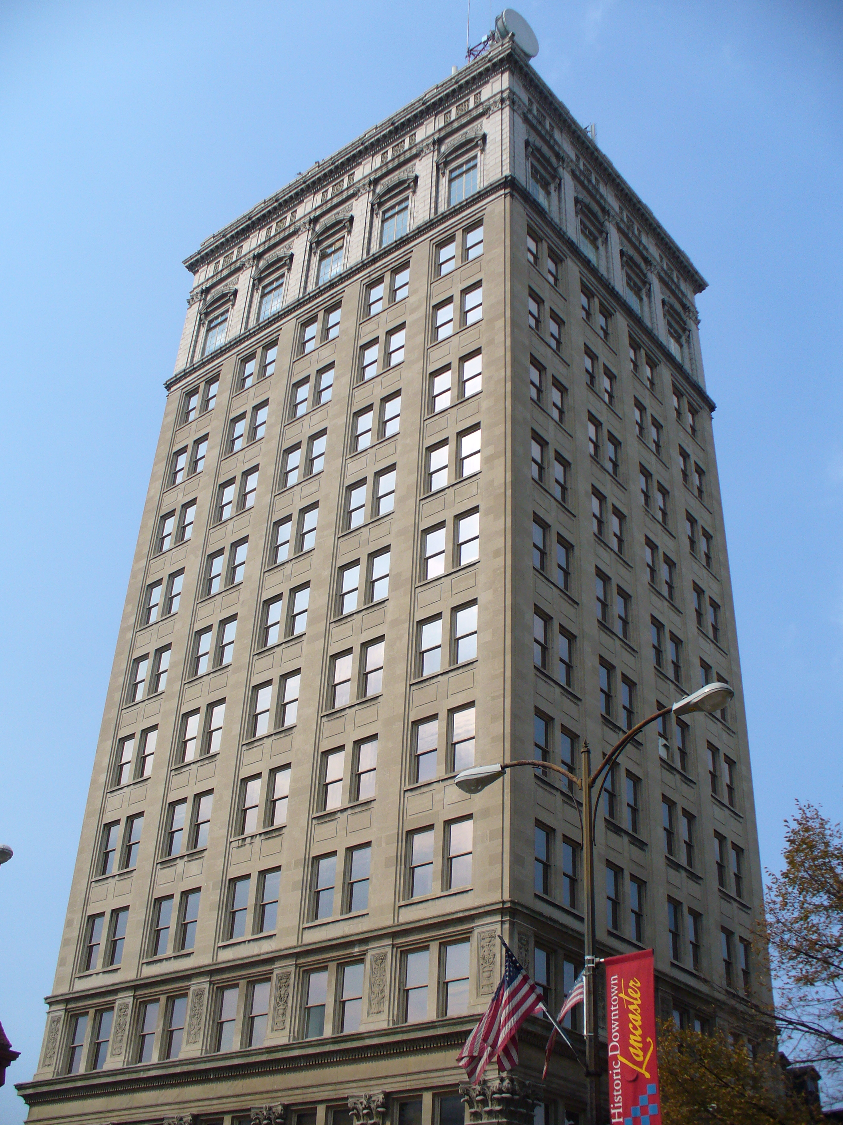
Response Latency
Clients
Servers
Clients
Longer Queue
Latency
“Cat”
Larger Latency, Possible SLO violations
“Cat”

Slide 6
Parallelism in MLaaS
Request Parallelism
Inter-op Parallelism
Intra-op Parallelism
Request
Operation
Request
Op.
Op.
Op.
Request
Th.
Th.
Th.
Op.
Op.
Op.
Th.
Th.
Request
Request
Operation
Thread
[OSDI ’16] Tensorflow: A System for Large Scale Machine Learning
[CoRR ’15] MXNet: A Flexible and Efficient Machine Learning Library for Heterogeneous Distributed Systems

Slide 7
Admission Policy in MLaaS
Batch Size
Requests
Parallel Batch Threads
Batch timeout
[OSDI ’16] Tensorflow: A System for Large Scale Machine Learning
[CoRR ’15] MXNet: A Flexible and Efficient Machine Learning Library for Heterogeneous Distributed Systems

Slide 8
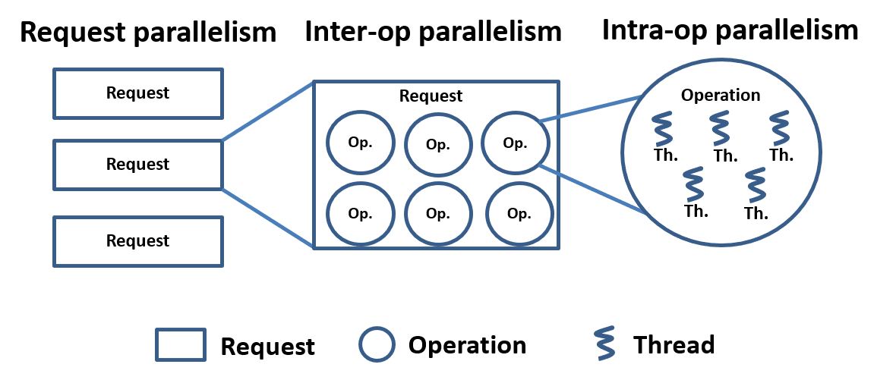
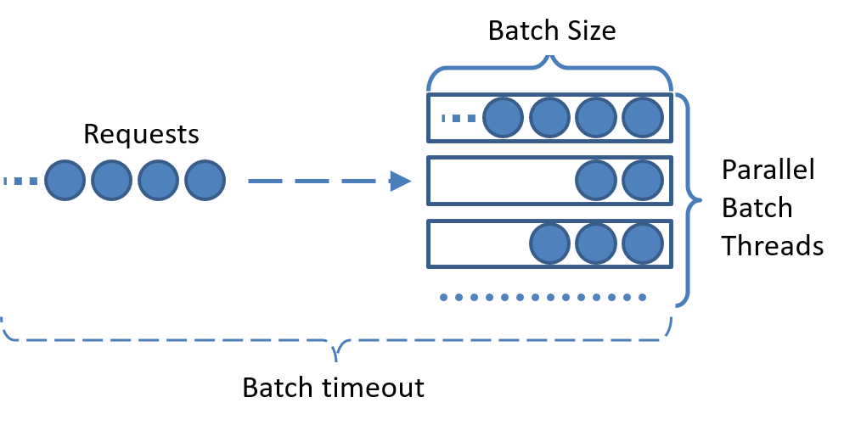
Problem
Dynamic Arrival Processes
Heterogeneous
Environments
Various Applications
?
Different Infrastructures
How to tune the system configuration?
Image from Azure

Slide 9
Problem Formulation
Scheduling
Algorithm
Minimize $r\left(s,c\right)$
Subject to $s∈𝒮,c∈𝒞$
$r\left(s,c\right)$ - Average request latency
$𝒮$ - Possible workloads
$𝒞$ - Possible system configs
Configuration$c=(c_{1},c_{2},c_{3},…)$
Workload$s$
Workload
$$s$$
MLaaS System
Notes:
变量改成斜体，set换成花体

Slide 10
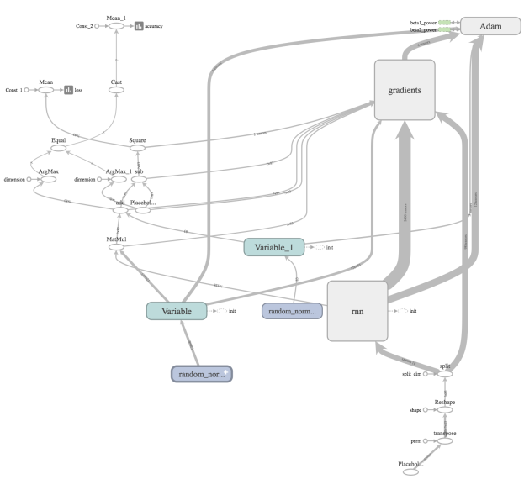
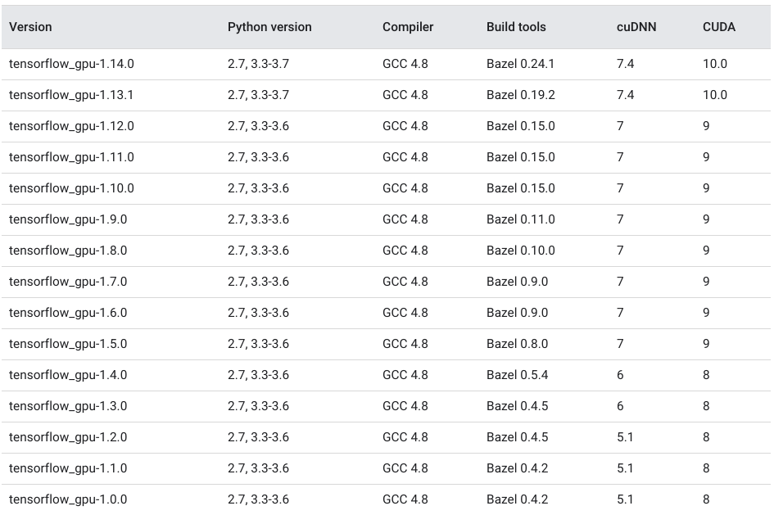
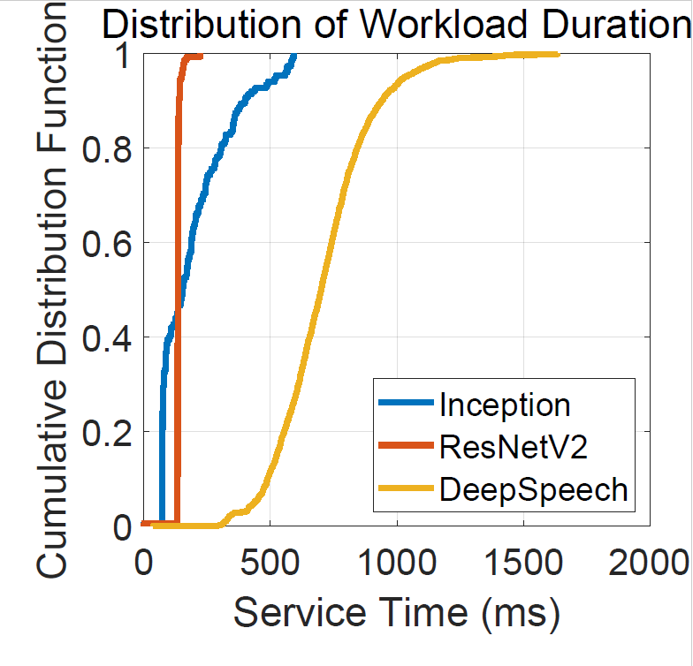
Related Work
Model Based
Most have assumption on workloads / applications
[SC ‘16] SERF: efficient scheduling for fast deep neural network serving via judicious parallelism
[INFOCOM ’17] Adaptive scheduling of parallel jobs in spark streaming.
Various Architectures
Fast Evolving Platforms
RNN
CNN
Heterogeneous Requests
Different Infrastructures
Failed due to:
Various Architectures
Fast Evolving Platforms
Heterogeneous Requests
Different Infrastructures

Slide 11
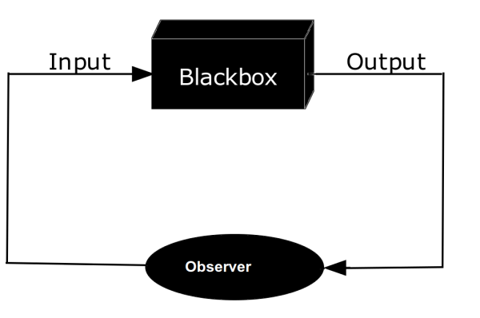
Related Work
Correlated Control Knobs
Model Free
Most are heuristic or learning based.
[NSDI ‘17] CherryPick: Adaptively Unearthing the Best Cloud Configurations for Big Data Analytics.
[ASPLOS ‘15] Few-to-Many: Incremental Parallelism for Reducing Tail Latency in Interactive Services.
Not Using Domain Knowledge
Too slow/costly due to:
high dimensional search space
failure to utilize domain knowledge

Slide 12
Reinforcement Learning
How to efficiently speed up convergence from $O(\frac{1}{t^{R}})$?
Policy
$$π:π\left(s,c\right)$$
Reinforcement Learning
How to speed up the learning?
Action
Configuration$c=(c_{1},c_{2},c_{3},…)$
Workload$s$
State
Reward
Workload
$$s$$
MLaaS System

Slide 13
Key Observation
versatile globally
vs
smooth locally

Slide 14
Key Observation
versatile globally
vs
smooth locally

Slide 15
Key Idea
Estimated
Observed
Use a single observation to update the configurations in a nearby region.

Slide 16
RRL Algorithm
The value of each action:
v$alue=previous value+estimation+future value$
The policy:
$$Prob. of config=\frac{exp. value of config }{exp. value of all configs}$$
$$estimation=f(config,observation)$$
Estimation Function
[1] Landau, Lev Davidovich & Lifshitz, Evgeny Mikhailovich (1980) [1976]. Statistical Physics. Course of Theoretical Physics. 5 (3 ed.). Oxford: Pergamon Press. ISBN 0-7506-3372-7.
Notes:
Need to talk about estimation error here.

Slide 17
Region based Reinforcement Learning
Convergence rate: $O(\frac{1}{t^{R}})$-> $O(\frac{1}{(n_{δ}{t)}^{R}})$
Policy
$$π:π\left(s,c\right)$$
Region based Reinforcement Learning
Action
Configuration$c=(c_{1},c_{2},c_{3},…)$
Workload$s$
State
Estimated
Reward
Estimation
Function
Workload
$$s$$
MLaaS System

Slide 18
Performance Analysis
- What’s the speedup of RRL?
Simulation Result
Convergence rate: $O(\frac{1}{t^{R}})$-> $O(\frac{1}{(n_{δ}{t)}^{R}})$
when $n_{δ}→1,$RRL degenerates to conventional RL
- What about the error?
Performance gap:
$$|RRL−\text{conventional} \text{RL}|≤O\left(\text{estimation} \text{error}\right)$$

Slide 19
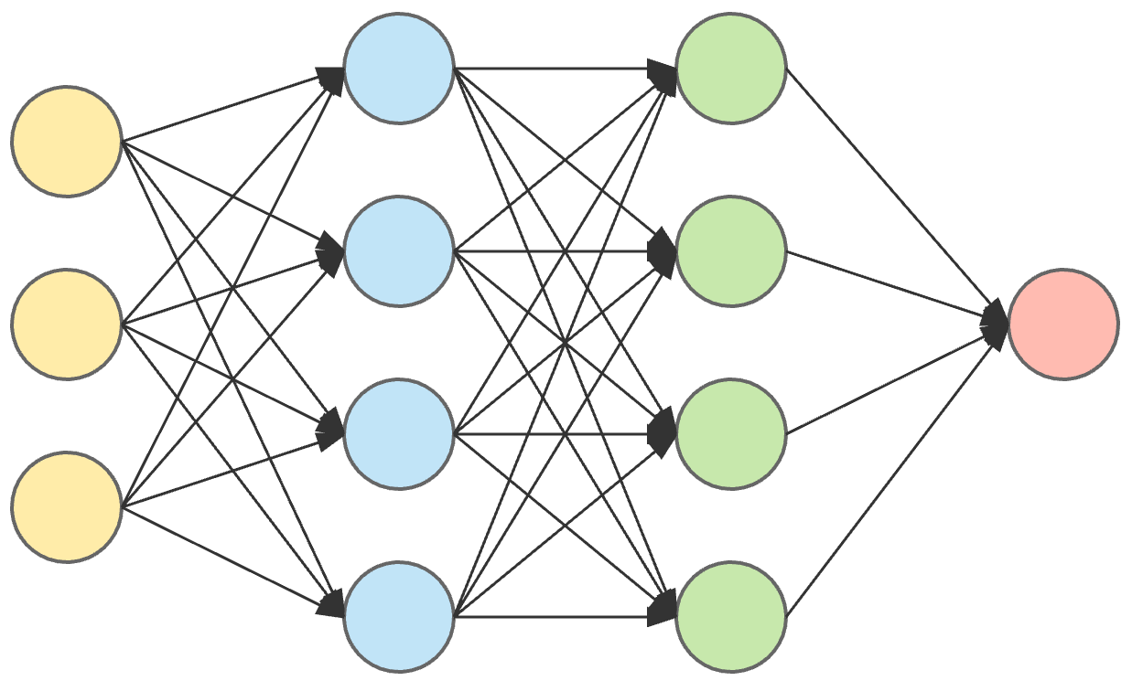
Estimation Function Implementation
Estimation Function $f$
Config
Estimated
Performance
Workload
2 hidden layers (256, 64 neurons)[1]
FTRL optimizer[2]
$$estimation=f(config,observation)$$
Estimation Function
[1] Justin Fu and Aviral Kumar and Matthew Soh and Sergey Levine (2019). Diagnosing Bottlenecks in Deep Q-learning Algorithms. In Proceedings of the 36th International Conference on Machine Learning, ICML 2019, 9-15 June 2019, Long Beach, California, USA
[2] J. D. Abernethy, E. Hazan, and A. Rakhlin, “Competing in the dark: An efficient algorithm for bandit linear optimization,” in 21st Annual Conference on Learning Theory - COLT 2008, Helsinki, Finland, July 9-12, 2008
Notes:
Neural Network is a common and promising function estimator. We choose this structure because its suitable representational capability

Slide 20
System Design
Update scheduling policy in real-time by RRL
Training Scheduling
Monitor system performance
RRL-based Scheduling Framework
Region-based Reinforcement Learning
Reward
Change configuration according to workload level
State
Update
Performance
Profiler
Load
Reward
Load
Scheduling Policy
Function
Runtime Information
Configuration
Machine Learning
Serving Server
Request
Clients
Respond

Slide 21
System Design
Update scheduling policy in real-time by RRL
Training Scheduling
Monitor system performance
RRL-based Scheduling Framework
Region-based Reinforcement Learning
Reward
Change configuration according to workload level
State
Update
Performance
Profiler
Load
Reward
Load
Scheduling Policy
Function
Runtime Information
Configuration
Machine Learning
Serving Server
Request
Clients
Respond

Slide 22
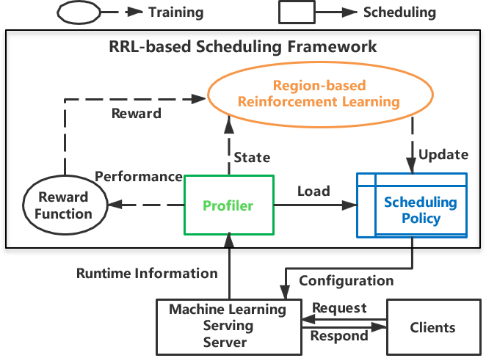
System Implementation
We prototyped our system on Tensorflow Serving
Profiler: DirectSession and gRPC modules, NVIDIA-SMI.
Scheduler: ModelServer
RRL: Tensorflow

Slide 23
Evaluation Setup
Arrival Process
Wiki: Wikipedia access trace.
Dynamic: concatenated Poisson arrival.
Hardware
A cluster of 10 nodes equivalent to AWS instance
GPU infrastructure equals to p3.8xlarge
CPU infrastructure equals to c5.4xlarge
Notes:
Arrival是否可删？

Slide 24
Evaluation
Applications
Inception V3: Deterministic
Inception ResNet V2 : Deterministic
Deep Speech V2: Stochastic
Baselines
DeepRM: job scheduling algorithm designed to work under limited resources [HotNets ‘16]
CAPES: system parameter tuning algorithm [SC ‘17]
Notes:
Baselines: They target system tuning; they are point based reinforcement learning

Slide 25
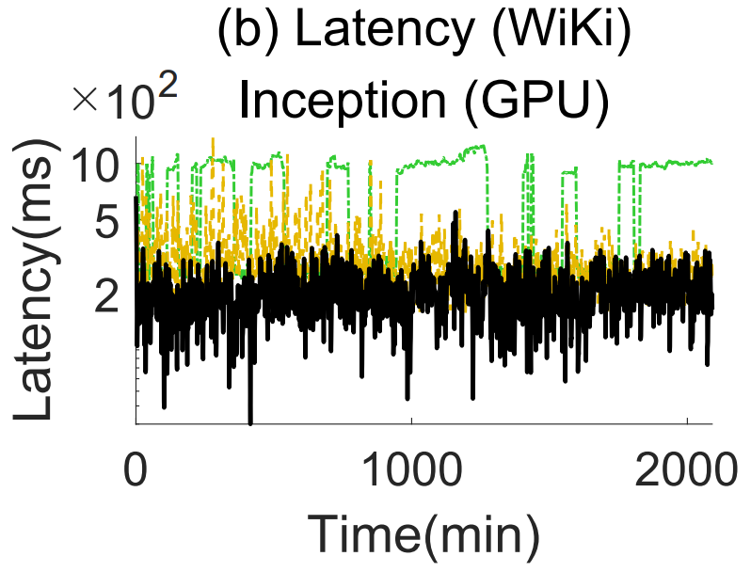
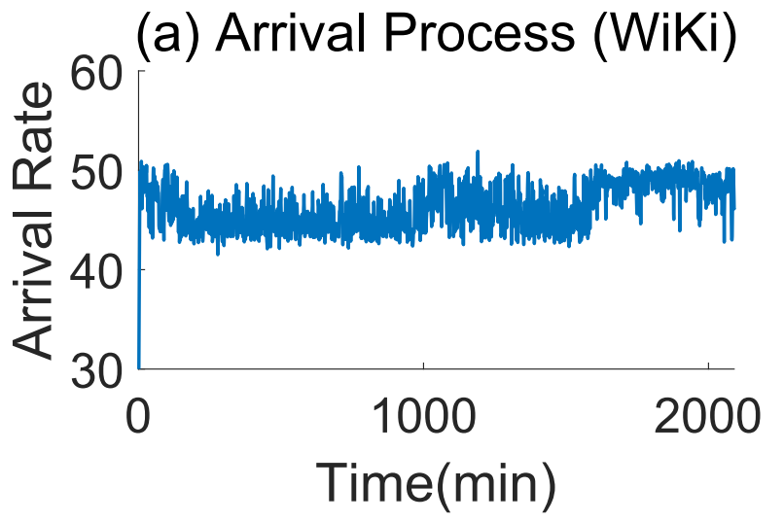
Minimizing Latency – Wiki
CAPES
DeepRM
RRL
RRL has 47% less average latency than CAPES and 30% than DeepRM.

Slide 26
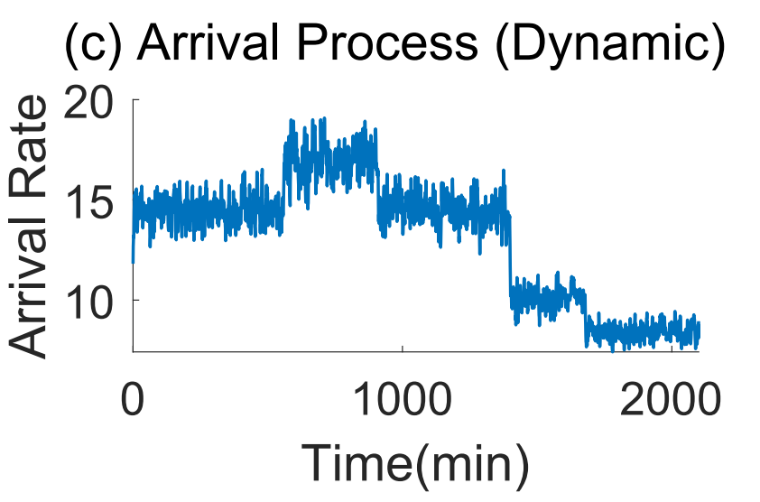
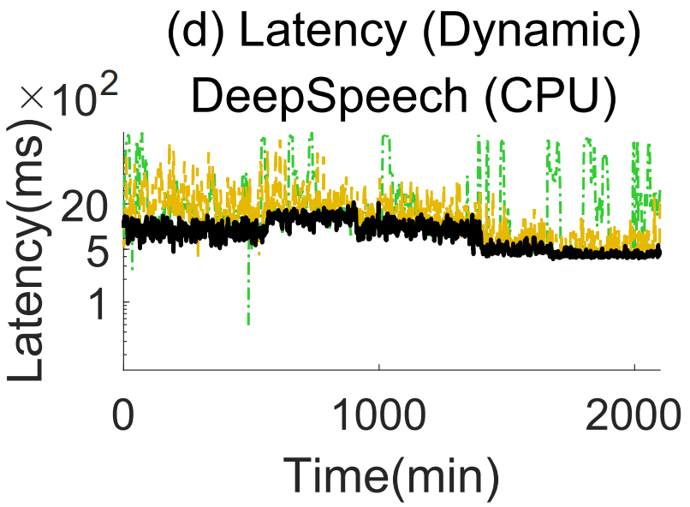
Minimizing Latency – Dynamic
CAPES
DeepRM
RRL
RRL has 63% less average latency than CAPES and 49% than DeepRM.

Slide 27
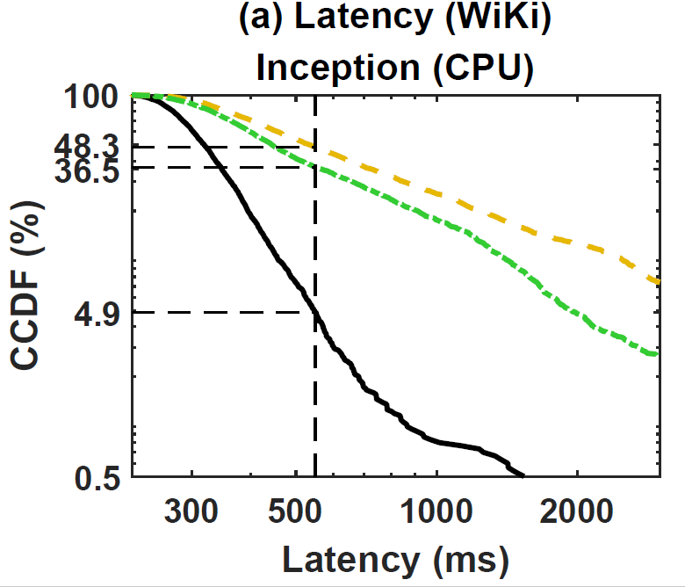
Complementary Cumulative Distribution Function
Please note that the Y-axis is log scale
The 95 percentile of RRL is 550ms
Notes:
Neural Network is a common and promising function estimator. We choose this structure because its suitable representational capability

Slide 28
Meeting SLO With Minimum Resources
RRL has 49% less SLO violation than CAPES and 43% than DeepRM.
RRL has 52% less CPU usage than CAPES and 46% than DeepRM.

Slide 29
Conclusion
Key insight: when MLaaS parallelism changes, the latency is versatile globally while smooth locally.
RRL : use a single observation to estimate nearby configurations.
can achieve near optimal solution.
converges much faster than conventional RL
has performance and convergence guarantees.

Slide 30
Thank you!
Questions?
Heyang Qin, looking for internships.
heyang_qin@nevada.unr.edu, https://www.cse.unr.edu/~heyangq/
This work is supported by National Science Foundation, Amazon Web Services and University of Nevada, Reno.

Slide 31
Auxiliary Slides

Slide 32
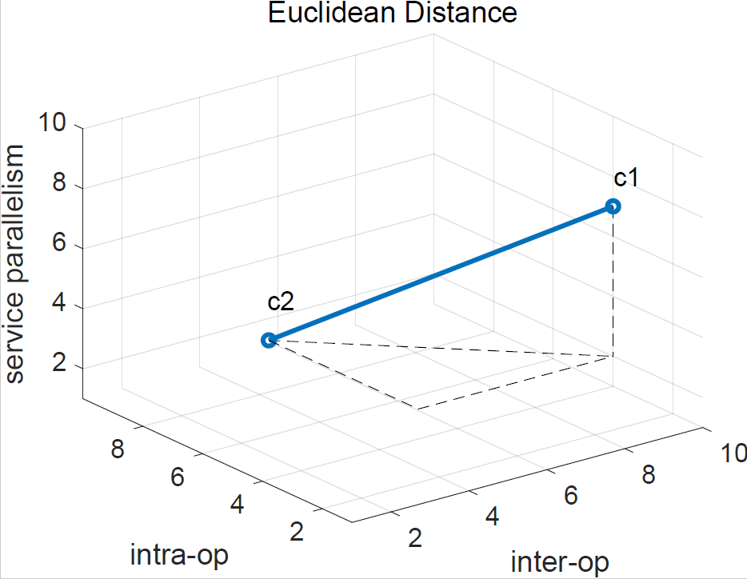
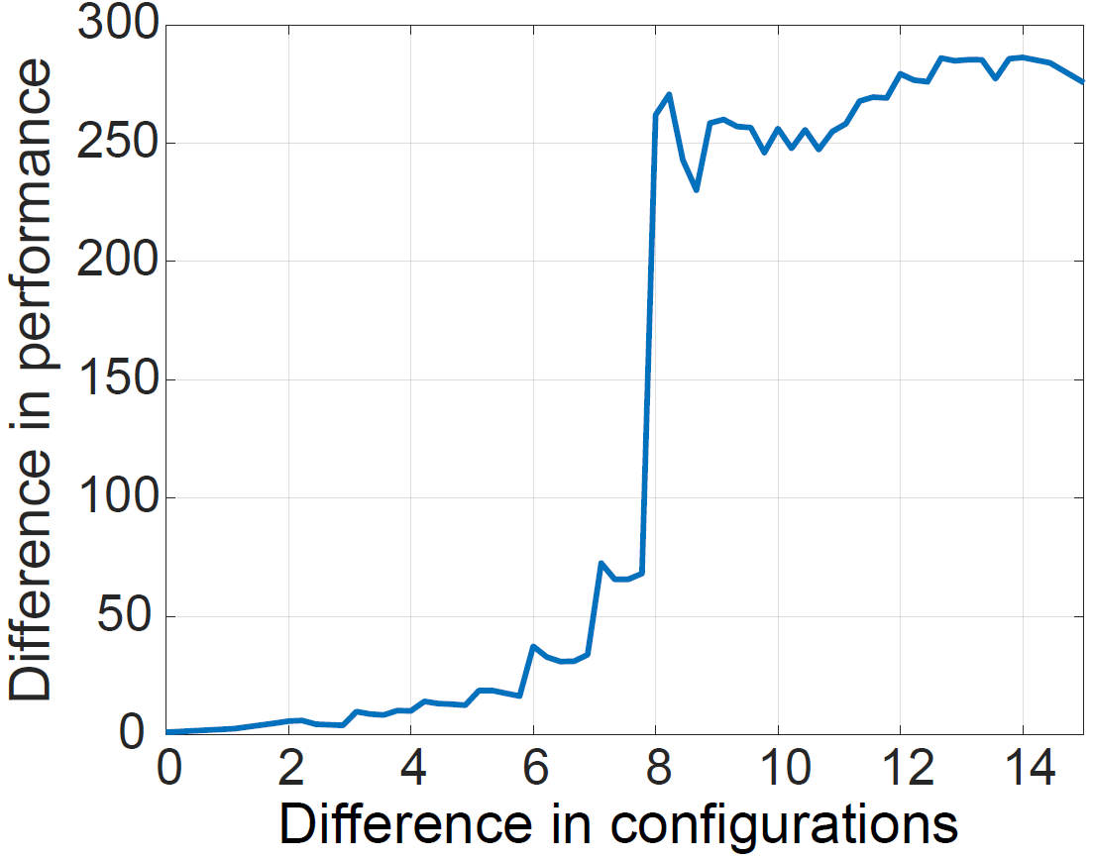
Validation of Observation
(%)
In small region, configurations’ performances are very similar
Notes:
Neural Network is a common and promising function estimator. We choose this structure because its suitable representational capability

Slide 33
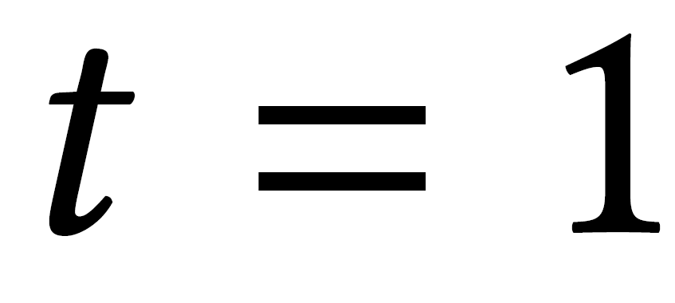
Convergence Proof
Value Update
Assume
Prove
When ,
At time $t$,
At time $t+1$,
Solving recurrence equation
Gives

Slide 34
Estimation Function Implementation
Estimation Function $f$
Config
Estimated
Performance
Workload
2 hidden layers (256, 64 neurons)[1]
FTRL optimizer[2]
$$estimation=f(config,observation)$$
Estimation Function
[1] Justin Fu and Aviral Kumar and Matthew Soh and Sergey Levine (2019). Diagnosing Bottlenecks in Deep Q-learning Algorithms. In Proceedings of the 36th International Conference on Machine Learning, ICML 2019, 9-15 June 2019, Long Beach, California, USA
[2] J. D. Abernethy, E. Hazan, and A. Rakhlin, “Competing in the dark: An efficient algorithm for bandit linear optimization,” in 21st Annual Conference on Learning Theory - COLT 2008, Helsinki, Finland, July 9-12, 2008
Notes:
Neural Network is a common and promising function estimator. We choose this structure because its suitable representational capability

Slide 35
Multi-Objective Optimization
Customized target function
$$r=\max\left(0,Latency−SLO \right)+Resouce Usage$$
Punishment for violating SLO
System resource usage
RRL has 49% less SLO violation than CAPES and 43% than DeepRM.
RRL has 52% less CPU usage than CAPES and 46% than DeepRM.
Notes:
Neural Network is a common and promising function estimator. We choose this structure because its suitable representational capability

